Slide 1
NEURAL ALGORITHMS
PERCEPTRON
G.SUPRAJA 2014063
G.SHOBAB 2014064

Slide 2
Biological Neural Networks
A Biological Neural Network refers to the information processing elements of the nervous system, called neurons.
A biological neuron is generally comprised of an axon which provides the input signals and is connected to other neurons via synapses.
The neuron reacts to input signals and may produce an output signal on its output connection called the dendrites.

Slide 3
Artificial Neural Networks (ANN)
The field of ANN is concerned with the investigation of computational models inspired by theories and observation of the structure and function of biological networks of neural cells in the brain.
They are adaptive systems capable of modifying their internal structure, typically the weights between nodes in the network.
Artificial Neural Networks are typically difficult to configure and slow to train, but once prepared are very fast in application.

Slide 4
Perceptron
It is a single layer feedforward neural network (single cell network) that inspired many extensions and variants.
A neuron accepts input signals via its dendrites, which pass the electrical signal down to the cell body.
The axon carry the signal out to synapses, which are the connections of a cell's axon to other cell's dendrites.
In a synapse, the electrical activity is converted into molecular activity. The molecular binding develops an electrical signal which is passed onto the connected cells dendrites.

Slide 5
Strategy
The information processing objective of the technique is to model a given function by modifying internal weightings of input signals to produce an expected output signal.
The system is trained using a supervised learning method, where the error between the system's output and a known expected output is presented to the system and used to modify its internal state.

Slide 6
Procedure
A weight is initialized for each input plus an additional weight for a fixed bias constant input that is almost always set to 1.0.
The activation of the network to a given input pattern is calculated as follows: activation = ∑^{n}_{k=1} (w_{k *} x_{ki} ) + w_{bias} * 1.0
where n is the number of weights and inputs, x_{ki} is the attribute on the input pattern, and is the bias weight.
The weights are updated as follows:
w_{i}(t+1) = w_{i}(t) + α * (e(t)-α(t)) * x_{i}(t)
where w_{i} is the i^{th} weight at time t and t+1 , α is the learning rate, e(t) and α(t) are the expected and actual output at time t , and x_{i} is the i^{th} input.

Slide 7
Algorithm
Input: ProblemSize, InputPatterns, iterationsMax, learnRate Output: Weights Weights = InitializeWeights(ProblemSize) For ( i = 1 To iterationsMax) Pattern_i = SelectInputPattern(InputPatterns) Activation_i = ActivateNetwork(Pattern_i, Weights) Output_i = TransferActivation(Activation_i) UpdateWeights( Pattern_i,Output_i,learnRate) End Return (Weights)

Slide 8
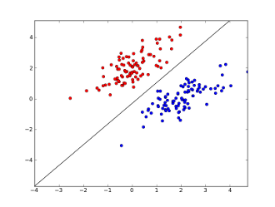
Geometric interpretation of a perceptron:
input patterns ( x 1,... ,x n ) are points in n-dimensional space
points with w ₀ + <w,x > = 0 are on a hyperplane
defined by w 0 and ~w
points with w ₀ + <w,x > >0 are above the hyperplane
points with w ₀ + <w,x > < 0 are below the hyperplane
perceptrons partition the input space into two
halfspaces along a hyperplane

Slide 9
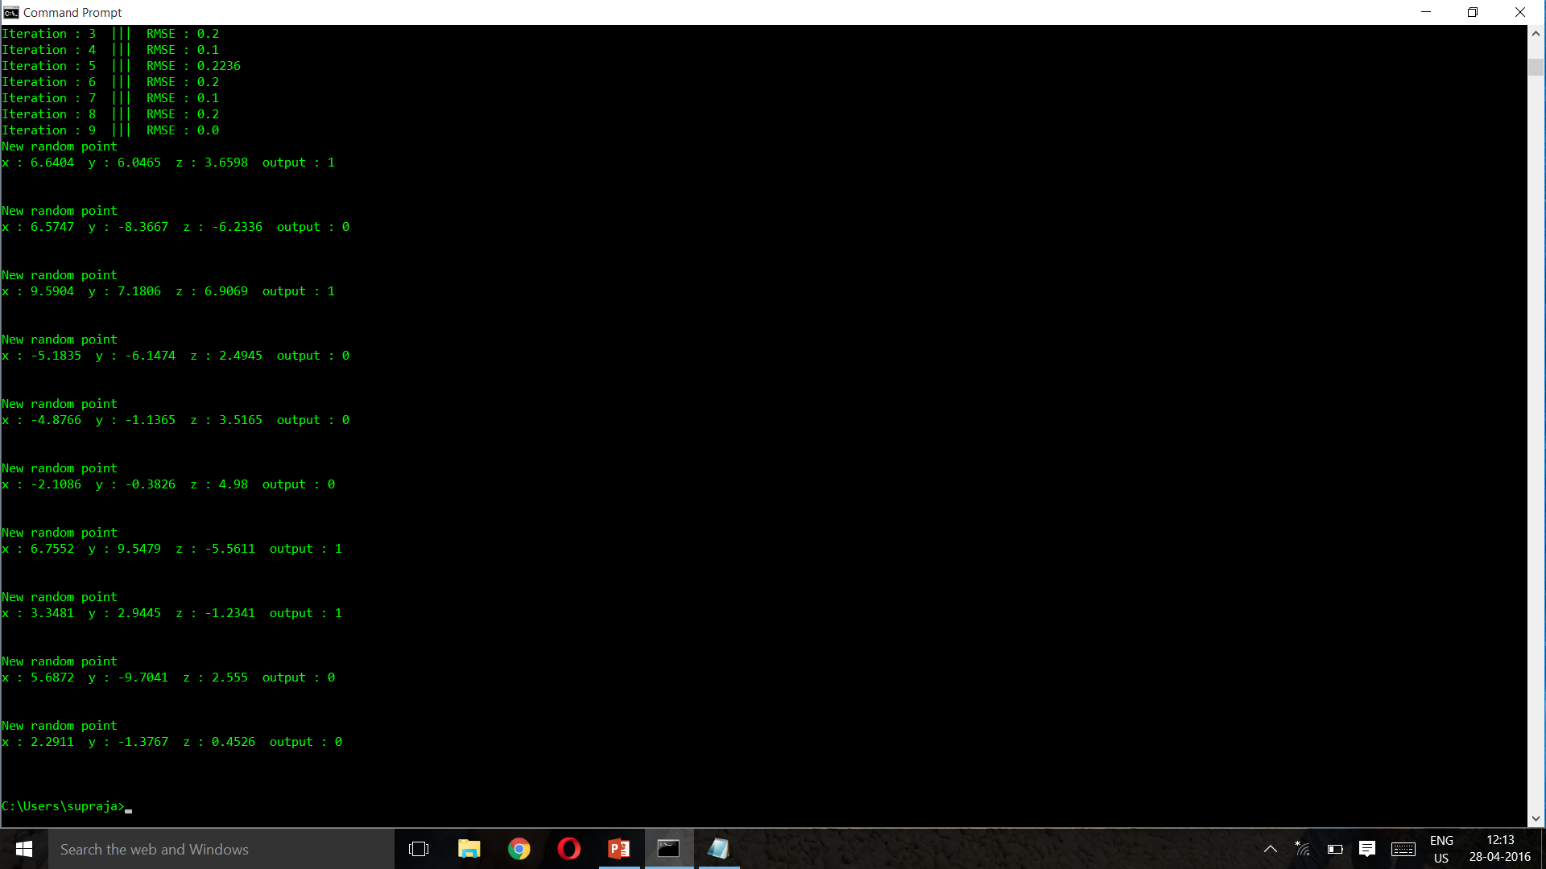

Slide 10
Heuristics
The Perceptron can be used to approximate arbitrary linear functions. The Perceptron cannot learn a non-linear mapping between the input and output attributes.
Input and output values should be normalized such that x€[0,1).
The learning rate (α€ [0, 1]) controls the amount of change each error has on the system, lower learning rages are common such as 0.1.
A bias weight is used with a constant input signal to provide stability to the learning process.
A step transfer function is commonly used to transfer the activation to a binary output value 1 = activation ≥ 0, otherwise 0.
The initial weights are typically small random values, typically € [0,0.5] .

Slide 11
Analasis:-
If the given problem is solvable, perceptron learning terminates after at most ( n + 1) ² 2 ^{(n+1) log( n+1)} iterations.
But in this implementation, we have set the maximum iterations to 100.

